Slide 1
Sustainable
Amplifiers and Filters
Jim Honeyman
jim@4volts.com
Dr Mark Glickman
drmarkglickman@yahoo.com

Slide 2
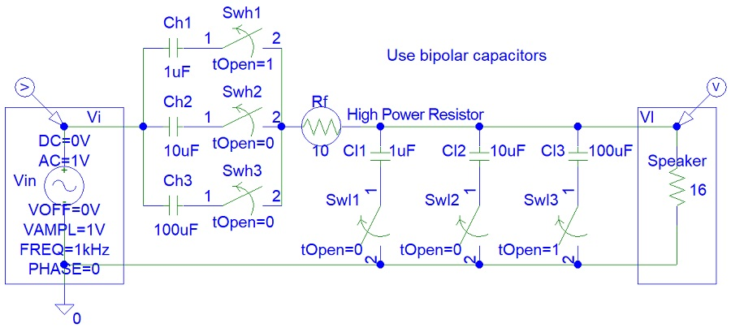
Simple Filter
Circuits design:

Slide 3
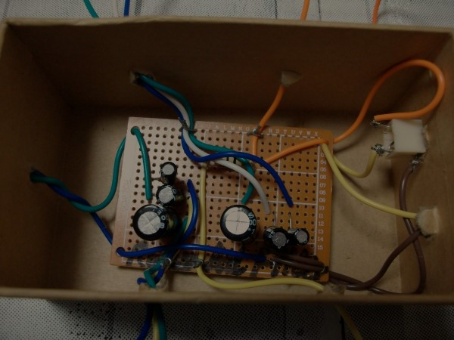
Simple Filter Photo
Circuit photo:

Slide 4
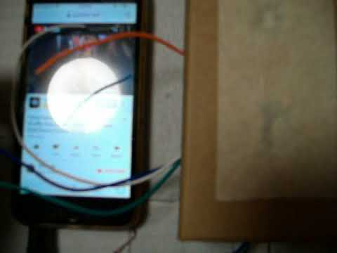
Simple Filter Video
Circuit video:

Slide 5
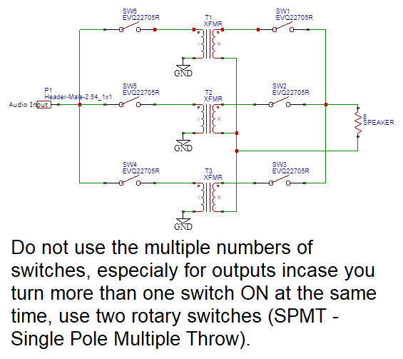
Recycled Audio Transformer System
Circuit design:

Slide 6
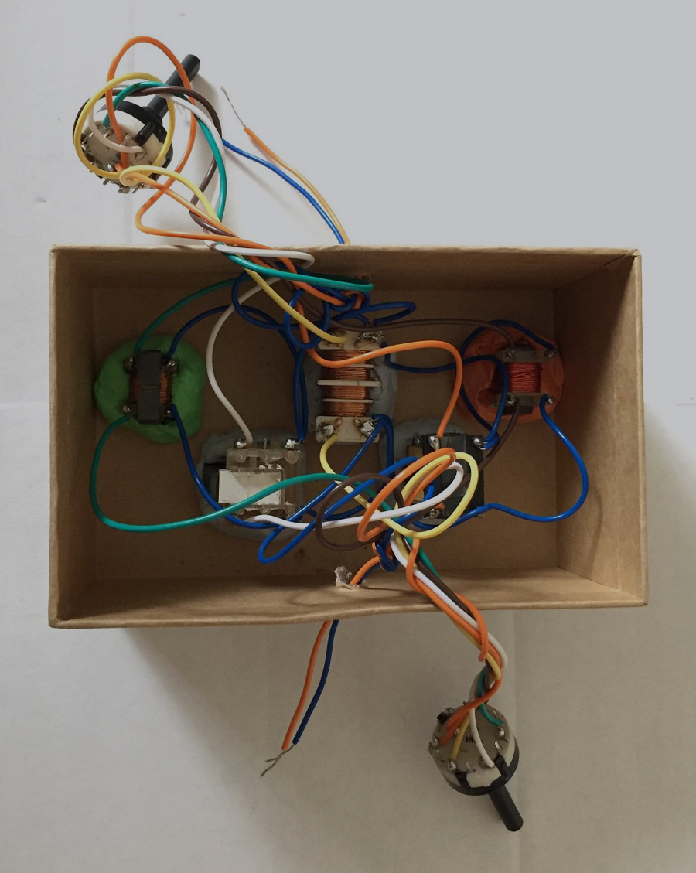
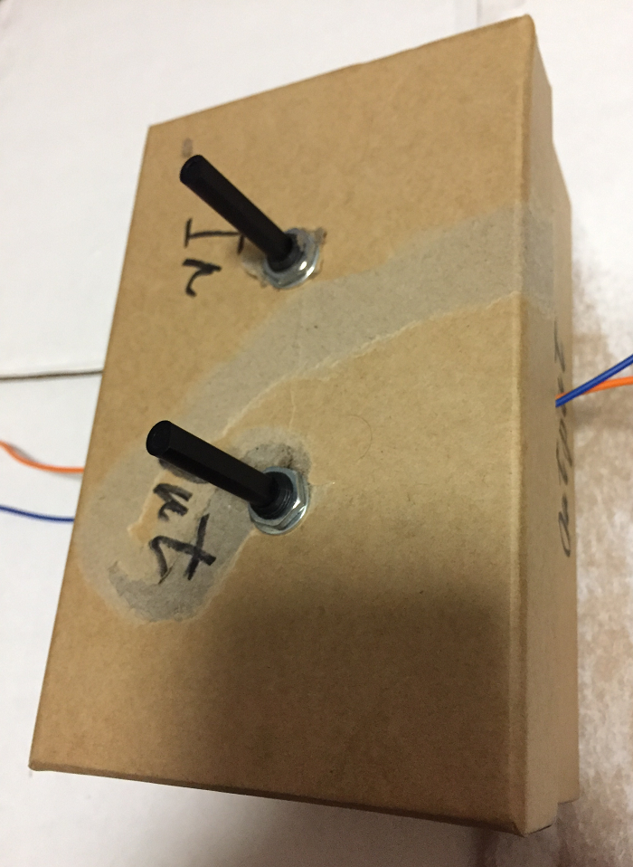
Recycled Audio Transformer System Photos
Photos:

Slide 7
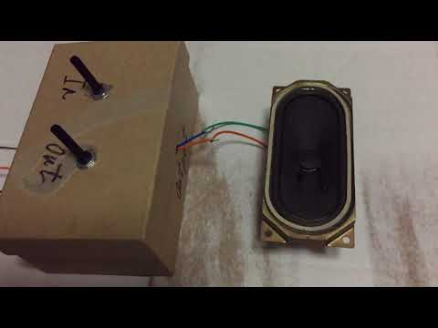
Recycled Audio Transformer System Video
Video:

Slide 8
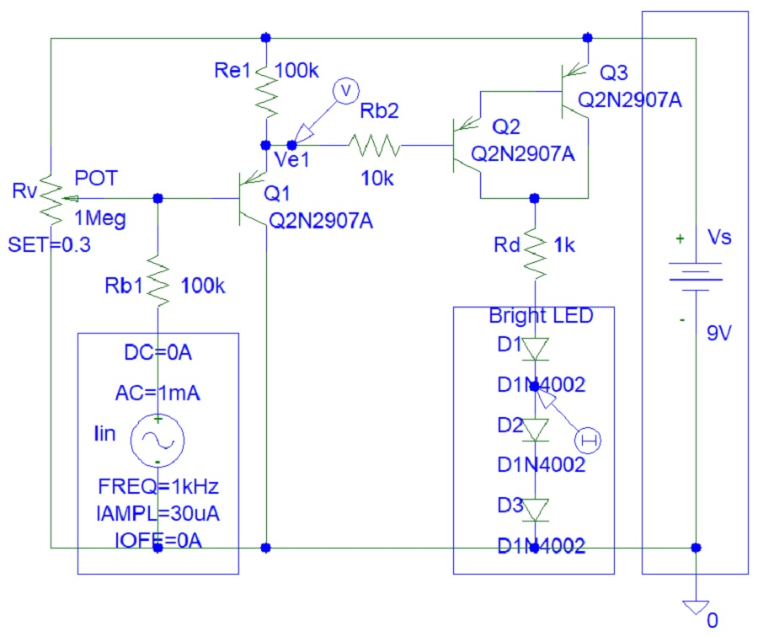
Transistor DC Amplifier
DC Amplifiers are not very effective:

Slide 9
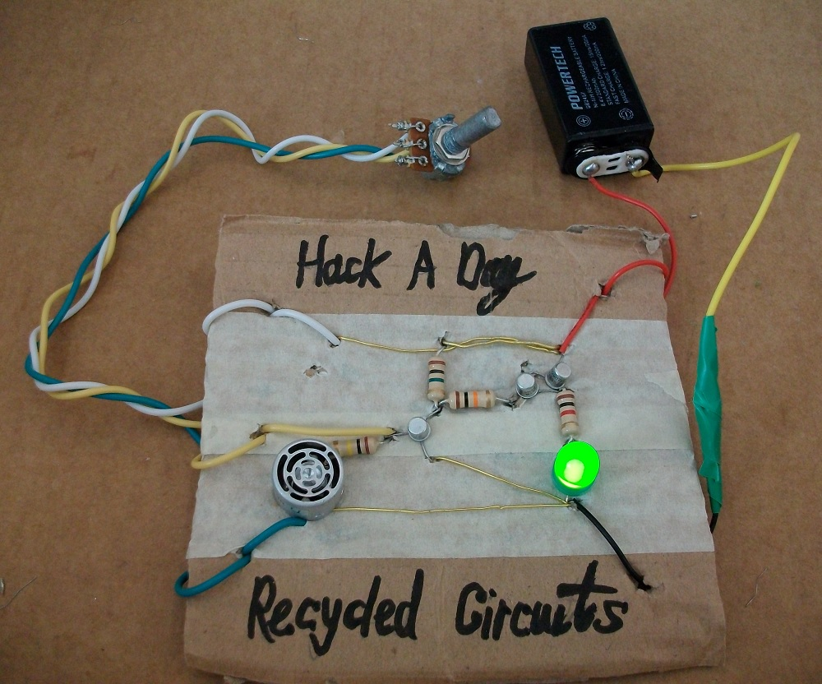
Transistor DC Amplifier Photo
Circuit photo:

Slide 10
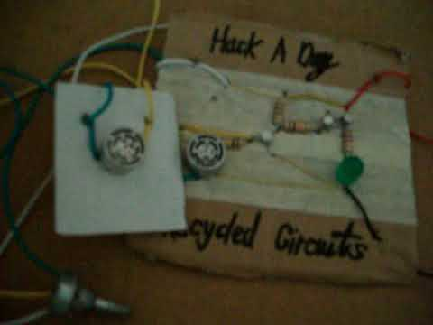
Transistor DC Amplifier Video
Video:

Slide 11
References
https://instructables.com/member/recycledcircuits
https://hackaday.io/recycledcircuits
https://instructables.com/member/recycledcomponents
https://hackaday.io/recycledcomponents
https://instructables.com/member/usedcomponents
https://hackaday.io/usedcomponents
https://instructables.com/member/recycledplanets
https://hackaday.io/recycledplanets
https://instructables.com/member/recycledsculptures
https://hackaday.io/recycledsculptures

Slide 12
References
https://instructables.com/member/diyelectronics
https://hackaday.io/diyelectronics
https://instructables.com/member/simplecircuits
https://hackaday.io/simplecircuits
https://instructables.com/member/cheapcircuits
https://hackaday.io/cheapcircuits
https://instructables.com/member/supercircuits
https://hackaday.io/supercircuits
https://instructables.com/member/basicmechanics
https://hackaday.io/basicmechanics

Slide 13
References
https://instructables.com/member/webaerospace
https://hackaday.io/webaerospace
https://instructables.com/member/webphotos
https://hackaday.io/webphotos
https://instructables.com/member/simplecomponents
https://hackaday.io/simplecomponents
https://instructables.com/member/cheapcomponents
https://hackaday.io/cheapcomponents
https://instructables.com/member/lowcostcircuits
https://hackaday.io/lowcostcircuits

