Slide 1
Sustainable Digital ICs 1
Jim Honeyman
jim@4volts.com
Dr Mark Glickman
drmarkglickman@yahoo.com

Slide 2
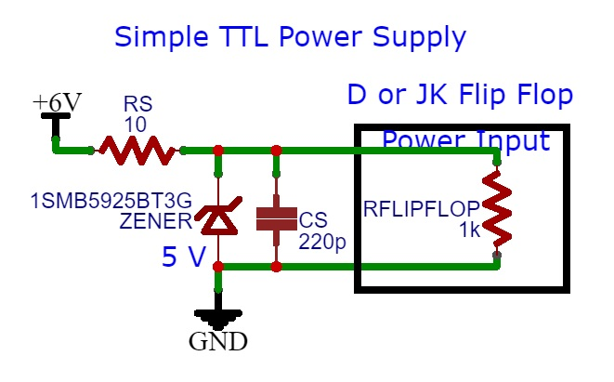
TTL IC Power Supply
Transistor Transistor Logic power supply:

Slide 3
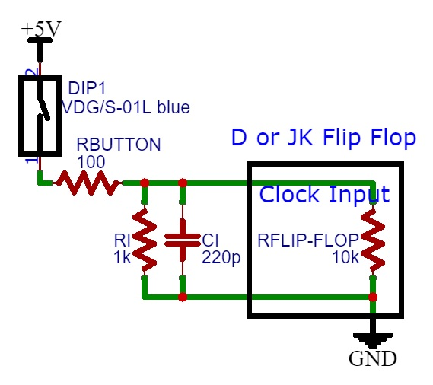
TTL IC Connecting Input
Transistor Transistor Logic input:

Slide 4
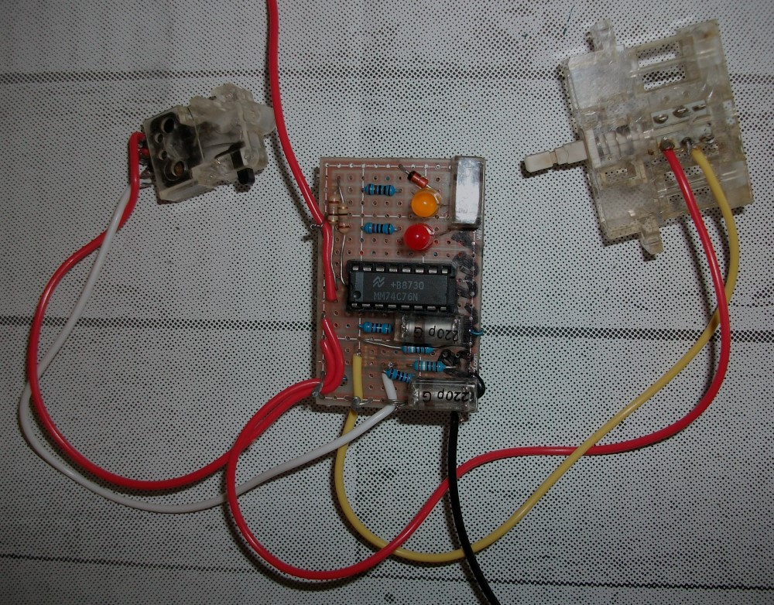
Button ON/OFF Switch Photo
You can use D Flip-Flop and JK Flip-Flop:

Slide 5
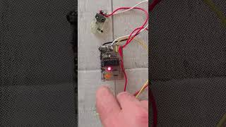
Button ON/OFF Switch Video

Slide 6
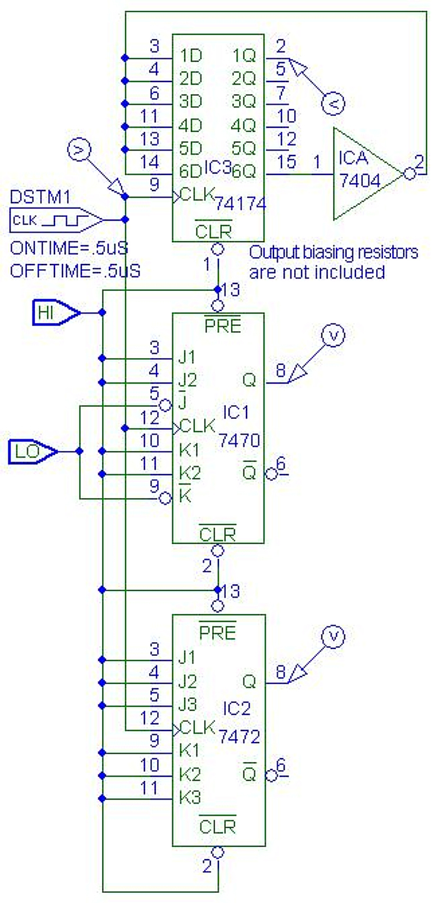
Button ON-OFF Switch
You can connect used TTL Flip-Flop ICs with wire wrap:

Slide 7
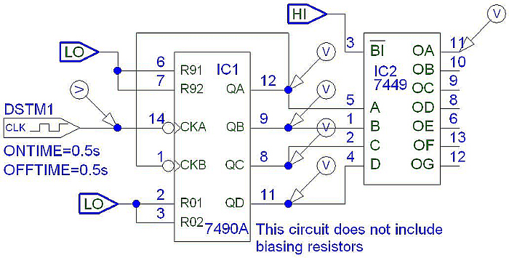
TTL Counters
TTL 7490A Decade Counter:

Slide 8
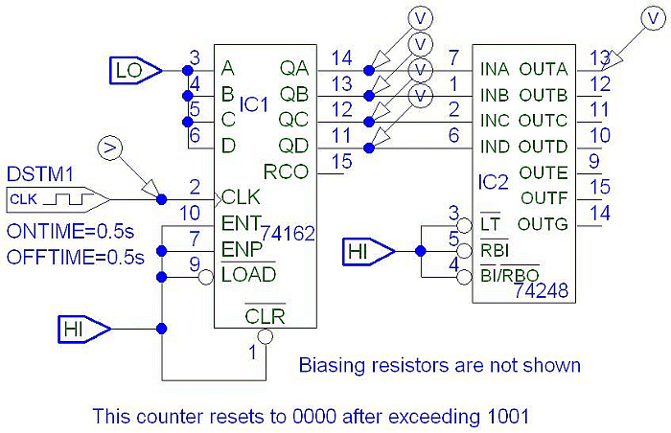
TTL Counters
TTL 74162 Decade Counter:

Slide 9
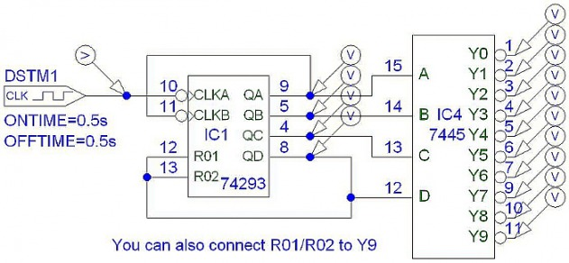
TTL Counters
TTL 74293 Decade Counter:

Slide 10
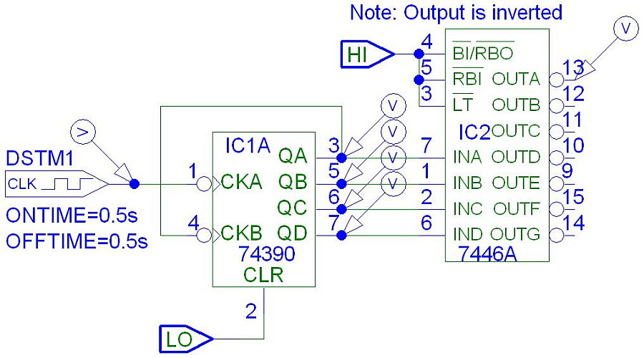
TTL Counters
TTL 74390 Decade Counter:

Slide 11
References
https://instructables.com/member/recycledcircuits
https://hackaday.io/recycledcircuits
https://instructables.com/member/recycledcomponents
https://hackaday.io/recycledcomponents
https://instructables.com/member/usedcomponents
https://hackaday.io/usedcomponents
https://instructables.com/member/recycledplanets
https://hackaday.io/recycledplanets
https://instructables.com/member/recycledsculptures
https://hackaday.io/recycledsculptures

Slide 12
References
https://instructables.com/member/diyelectronics
https://hackaday.io/diyelectronics
https://instructables.com/member/simplecircuits
https://hackaday.io/simplecircuits
https://instructables.com/member/cheapcircuits
https://hackaday.io/cheapcircuits
https://instructables.com/member/supercircuits
https://hackaday.io/supercircuits
https://instructables.com/member/basicmechanics
https://hackaday.io/basicmechanics

Slide 13
References
https://instructables.com/member/webaerospace
https://hackaday.io/webaerospace
https://instructables.com/member/webphotos
https://hackaday.io/webphotos
https://instructables.com/member/simplecomponents
https://hackaday.io/simplecomponents
https://instructables.com/member/cheapcomponents
https://hackaday.io/cheapcomponents
https://instructables.com/member/lowcostcircuits
https://hackaday.io/lowcostcircuits

