Slide 1
Sustainable Digital
ICs 2
Jim Honeyman
jim@4volts.com
Dr Mark Glickman
drmarkglickman@yahoo.com

Slide 2
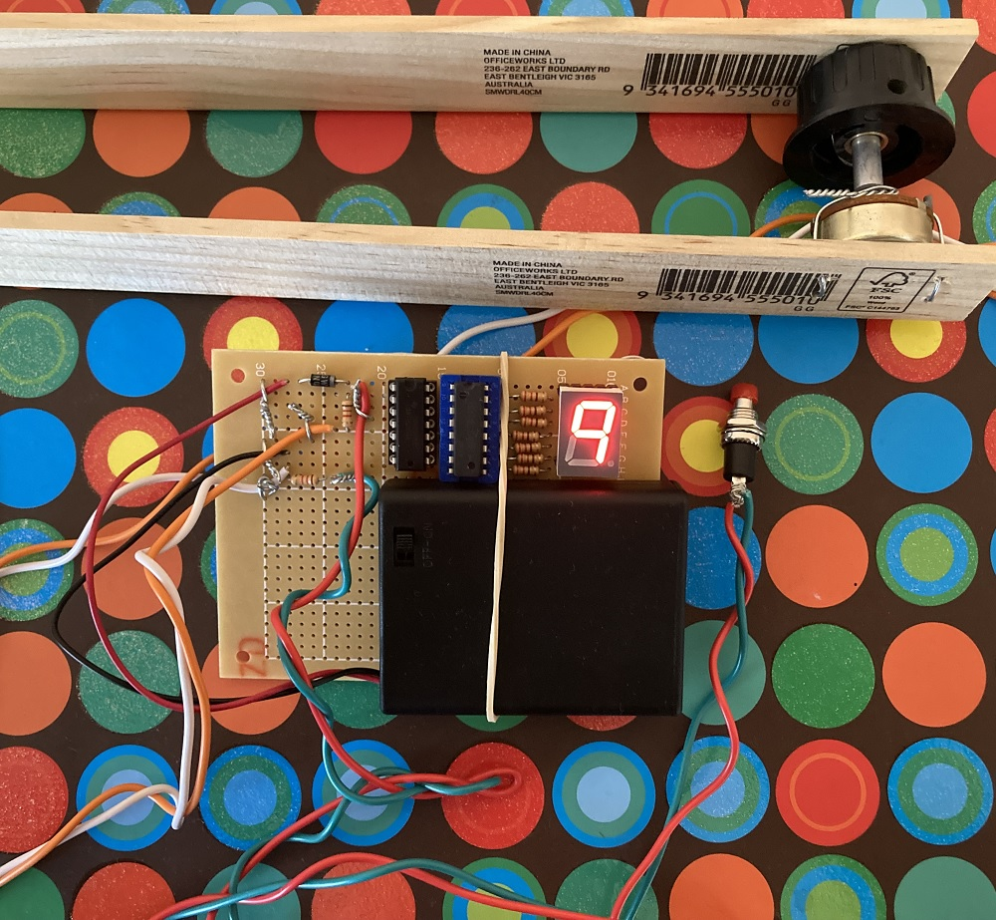
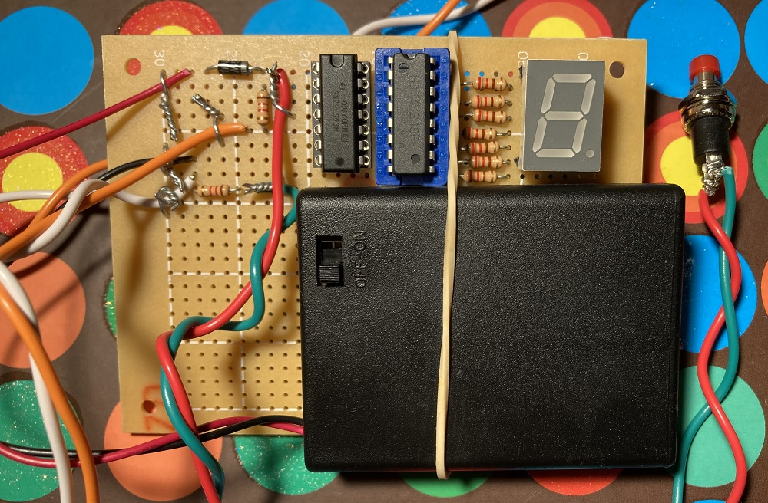
Exercise Meter (Photos)
This device uses mechanical sensor (variable resistor) to count the amount of times you bend your arm.

Slide 3
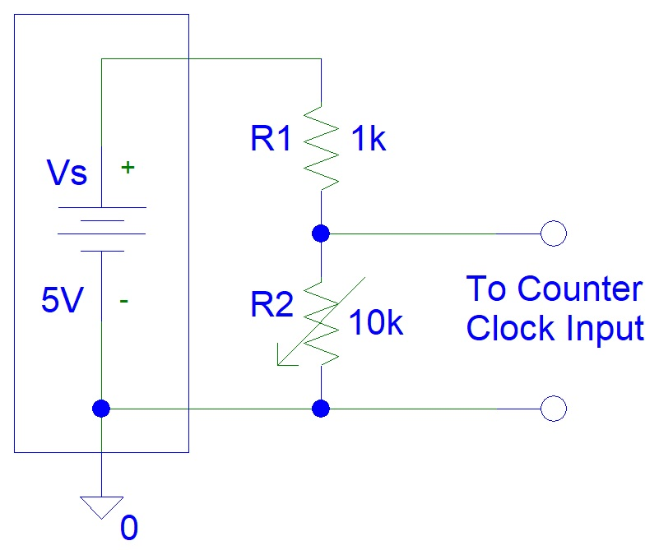
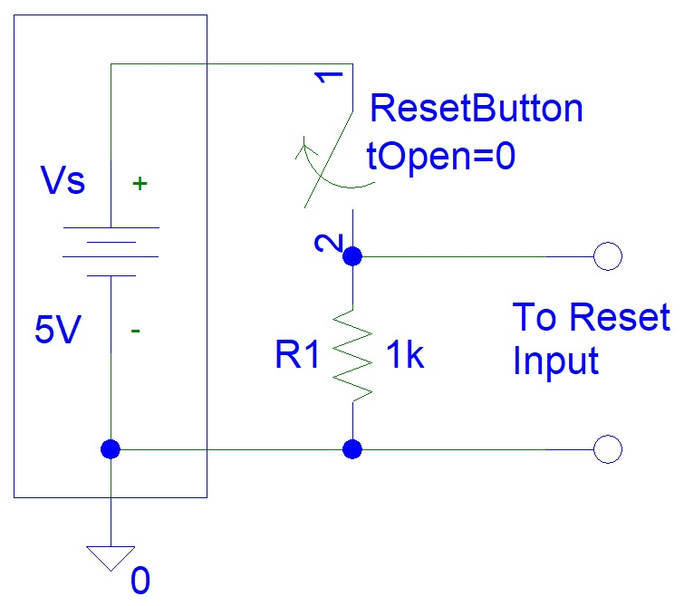
Exercise Meter (Circuits)
Variable Resistor Circuit and Reset Button Circuit (on the left circuit R1 resistor can be omitted if you are using a three pin variable resistor - potentiometer):

Slide 4
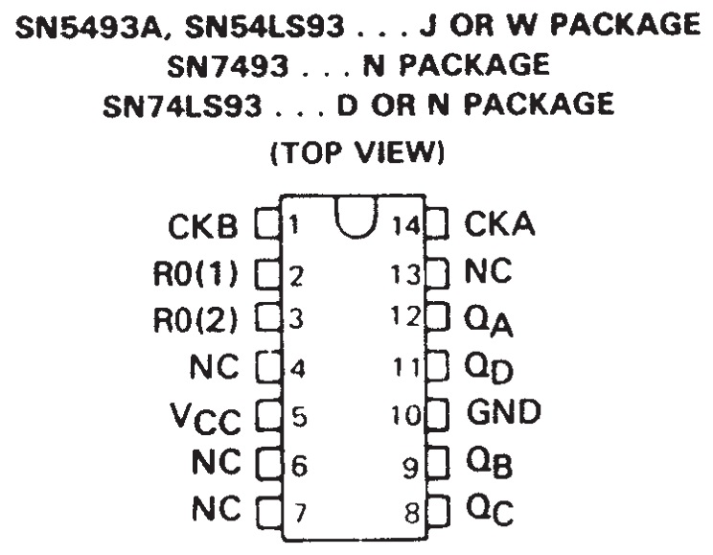
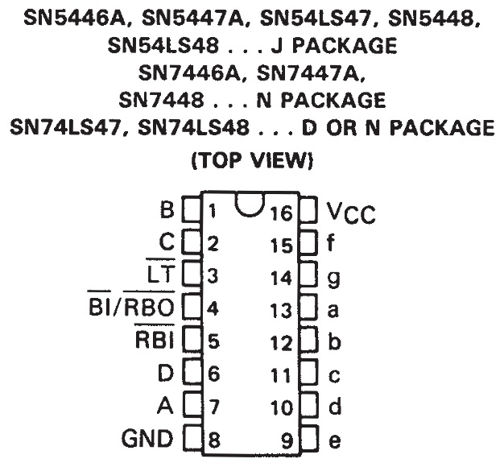
Exercise Meter (Circuits)
Binary Counter and BCD to 7-segment Display Driver ICs:

Slide 5
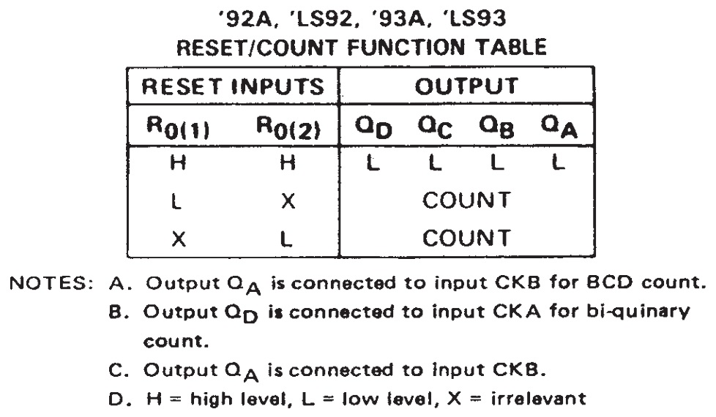
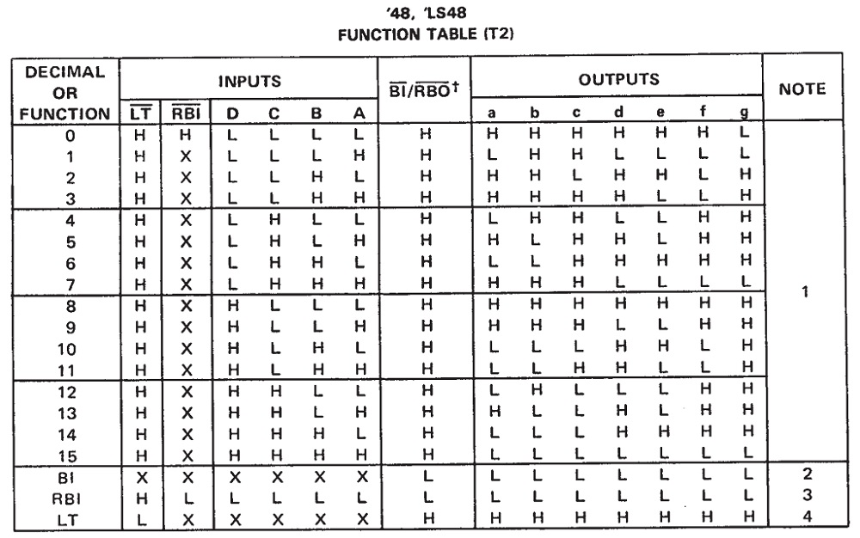
Exercise Meter (IC Datasheets)
Binary Counter and BCD to 7-segment Display Driver Function Tables:

Slide 6
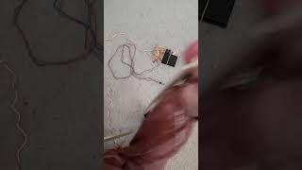
Exercise Meter (Video)

Slide 7
References
https://instructables.com/member/recycledcircuits
https://hackaday.io/recycledcircuits
https://instructables.com/member/recycledcomponents
https://hackaday.io/recycledcomponents
https://instructables.com/member/usedcomponents
https://hackaday.io/usedcomponents
https://instructables.com/member/recycledplanets
https://hackaday.io/recycledplanets
https://instructables.com/member/recycledsculptures
https://hackaday.io/recycledsculptures

Slide 8
References
https://instructables.com/member/diyelectronics
https://hackaday.io/diyelectronics
https://instructables.com/member/simplecircuits
https://hackaday.io/simplecircuits
https://instructables.com/member/cheapcircuits
https://hackaday.io/cheapcircuits
https://instructables.com/member/supercircuits
https://hackaday.io/supercircuits
https://instructables.com/member/basicmechanics
https://hackaday.io/basicmechanics

Slide 9
References
https://instructables.com/member/webaerospace
https://hackaday.io/webaerospace
https://instructables.com/member/webphotos
https://hackaday.io/webphotos
https://instructables.com/member/simplecomponents
https://hackaday.io/simplecomponents
https://instructables.com/member/cheapcomponents
https://hackaday.io/cheapcomponents
https://instructables.com/member/lowcostcircuits
https://hackaday.io/lowcostcircuits

