Slide 1
High School
Sustainable Lights 1
Jim Honeyman
jim@4volts.com
Dr Mark Glickman
drmarkglickman@yahoo.com

Slide 2
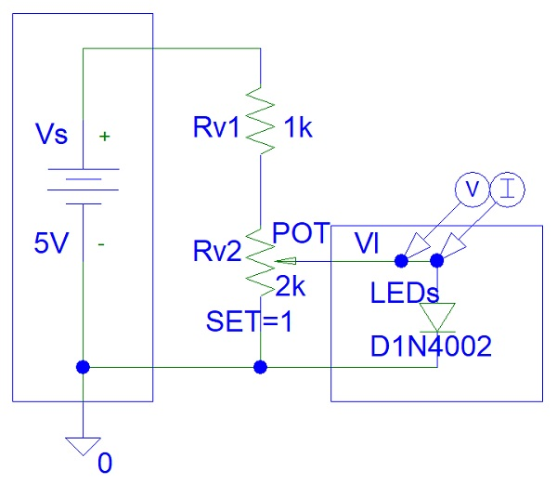
Recycled Light Dimmer
The 1 kohm resistor could be a bit too high for a voltage of only 5 V.

Slide 3
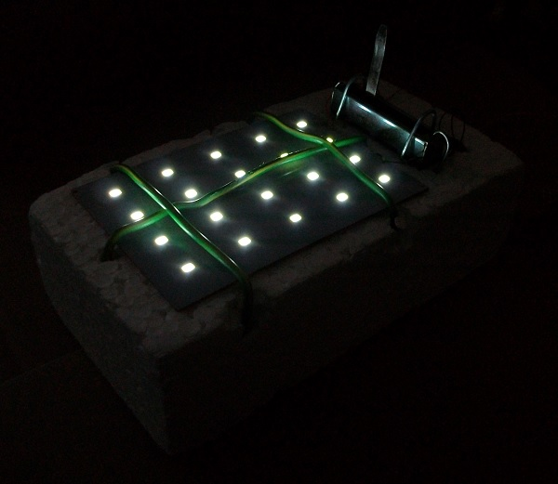
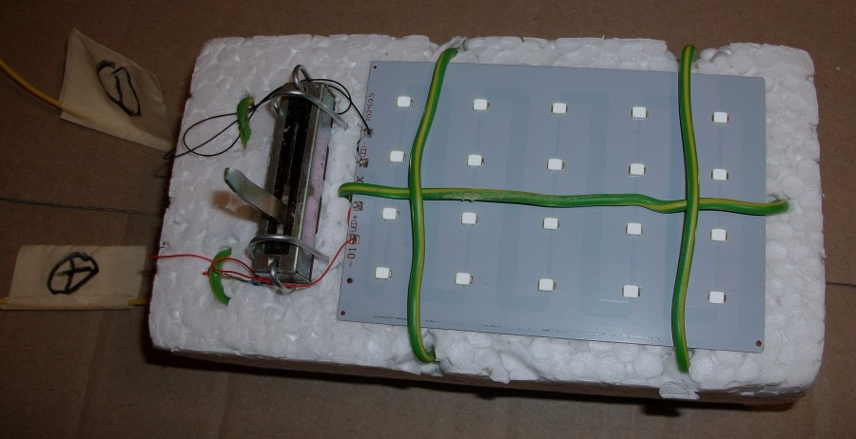
Recycled Light Dimmer
Photos:

Slide 4
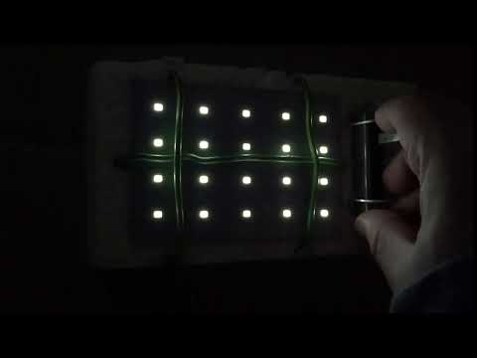
Recycled Light Dimmer
Video:

Slide 5
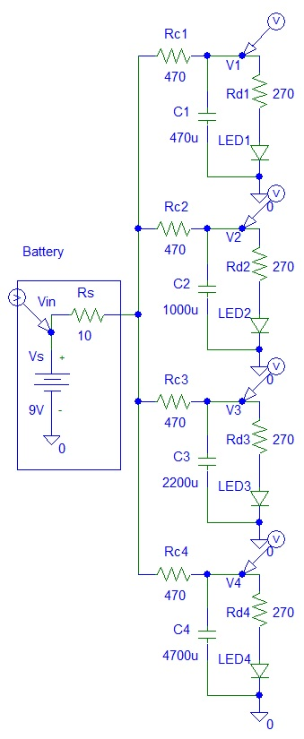
Christmas Lights
Circuit:

Slide 6
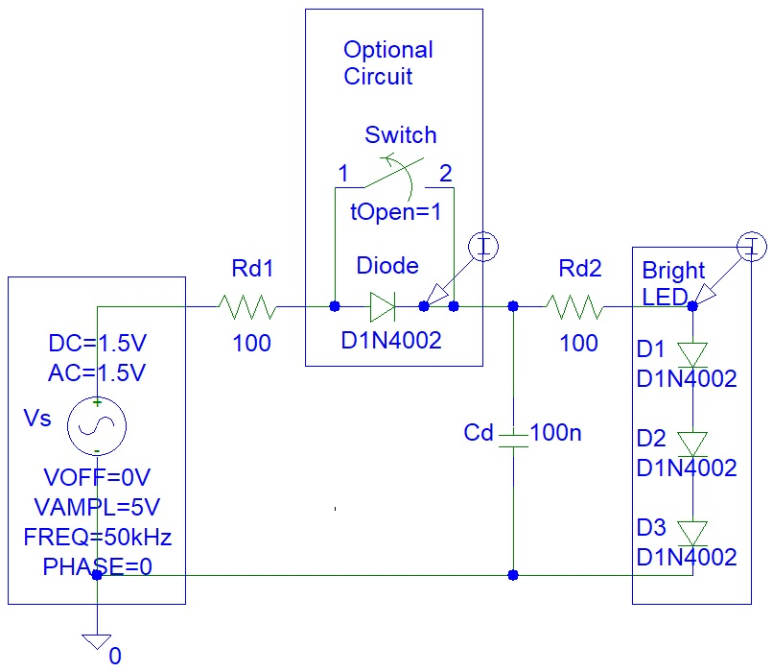
Frequency Light Dimmer
LED circuit:

Slide 7
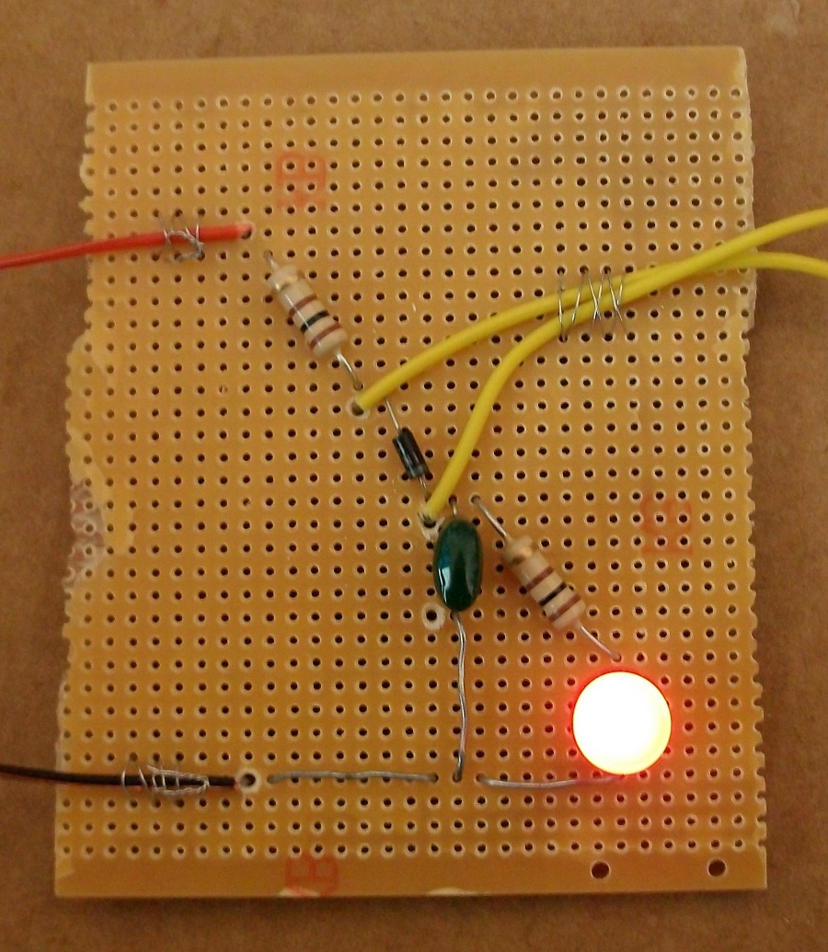
Frequency Light Dimmer Photo
Photo:

Slide 8
References
https://instructables.com/member/recycledcircuits
https://hackaday.io/recycledcircuits
https://instructables.com/member/recycledcomponents
https://hackaday.io/recycledcomponents
https://instructables.com/member/usedcomponents
https://hackaday.io/usedcomponents
https://instructables.com/member/recycledplanets
https://hackaday.io/recycledplanets
https://instructables.com/member/recycledsculptures
https://hackaday.io/recycledsculptures

Slide 9
References
https://instructables.com/member/diyelectronics
https://hackaday.io/diyelectronics
https://instructables.com/member/simplecircuits
https://hackaday.io/simplecircuits
https://instructables.com/member/cheapcircuits
https://hackaday.io/cheapcircuits
https://instructables.com/member/supercircuits
https://hackaday.io/supercircuits
https://instructables.com/member/basicmechanics
https://hackaday.io/basicmechanics

Slide 10
References
https://instructables.com/member/webaerospace
https://hackaday.io/webaerospace
https://instructables.com/member/webphotos
https://hackaday.io/webphotos
https://instructables.com/member/simplecomponents
https://hackaday.io/simplecomponents
https://instructables.com/member/cheapcomponents
https://hackaday.io/cheapcomponents
https://instructables.com/member/lowcostcircuits
https://hackaday.io/lowcostcircuits

