Slide 1
High School
Sustainable Lights 2
Jim Honeyman
jim@4volts.com
Dr Mark Glickman
drmarkglickman@yahoo.com

Slide 2
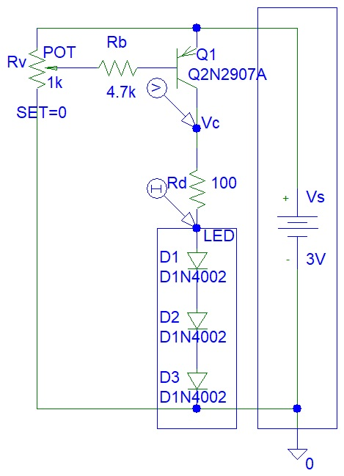
Transistor LED Dimmer
You will not need a transistor if use a typical low current LED.
Transistors can used to drive multiple LEDs.

Slide 3
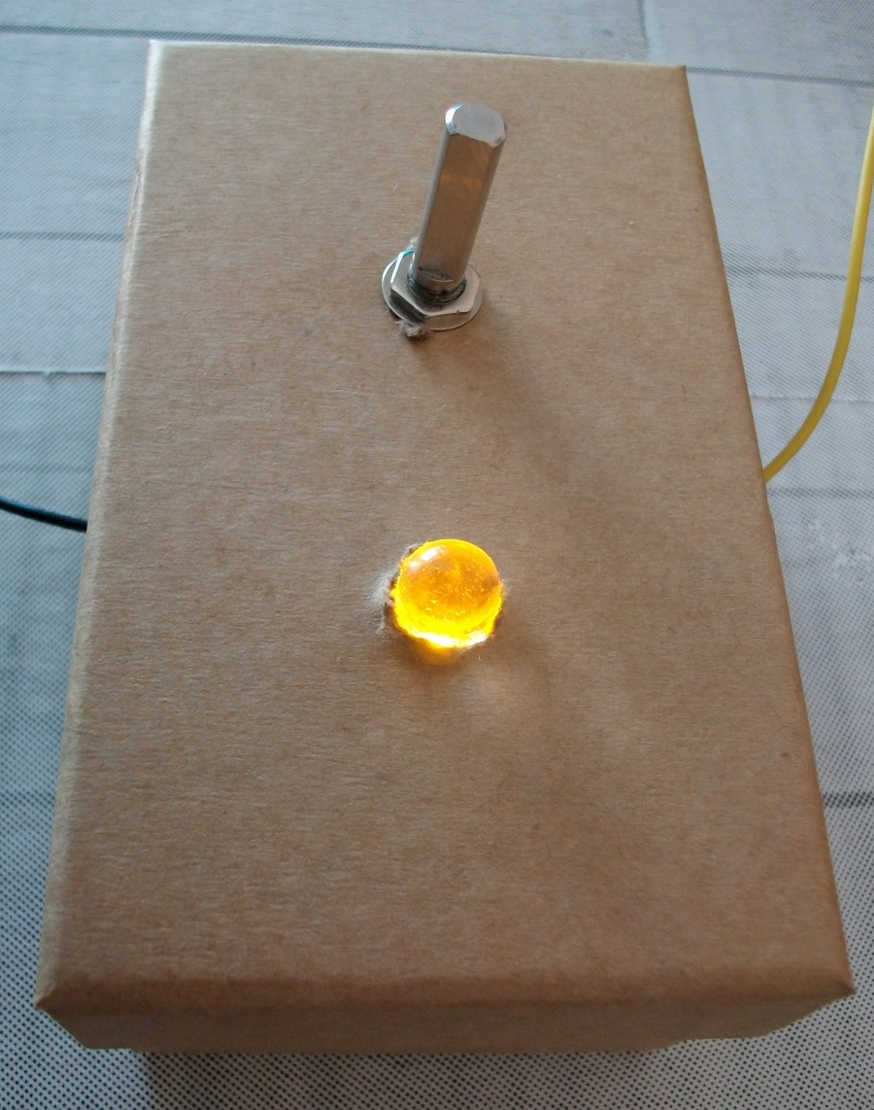
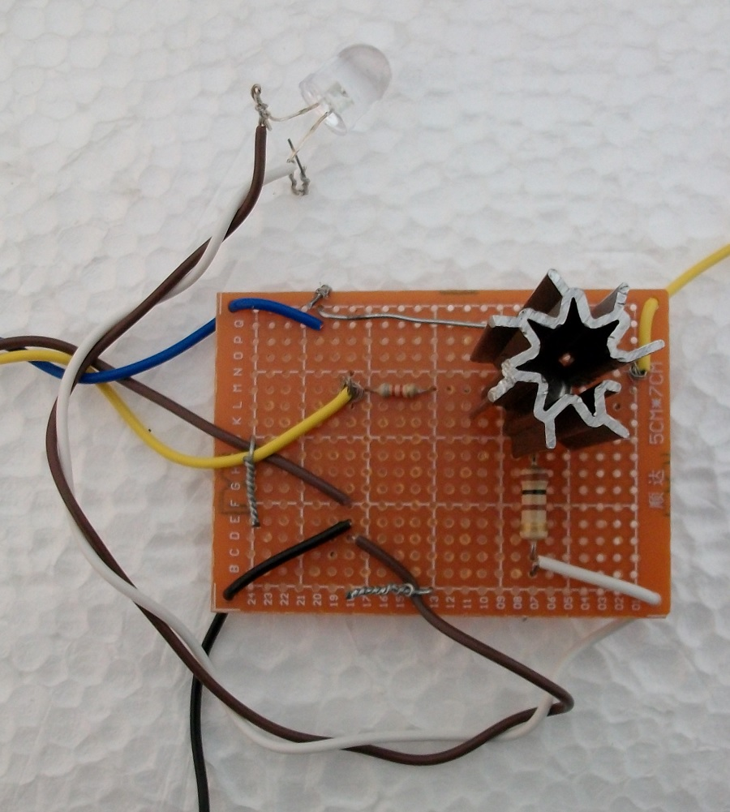
Transistor LED Dimmer
Photos:

Slide 4
Transistor LED Dimmer
Video:
https://www.youtube.com/shorts/RbYCCmnZXSM

Slide 5
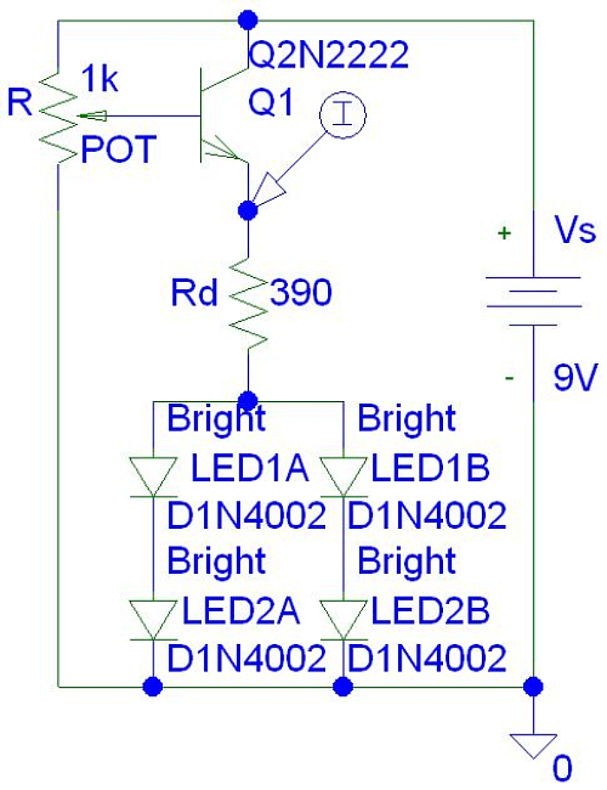
Transistor Light Dimmer
The LEDs might appear a bit dim unless you use a 5 mA LED.
(9 V - 0.7 V - 4 V) / 390 ohms = 11.02564102 mA
(5.51282051 mA per LED)

Slide 6
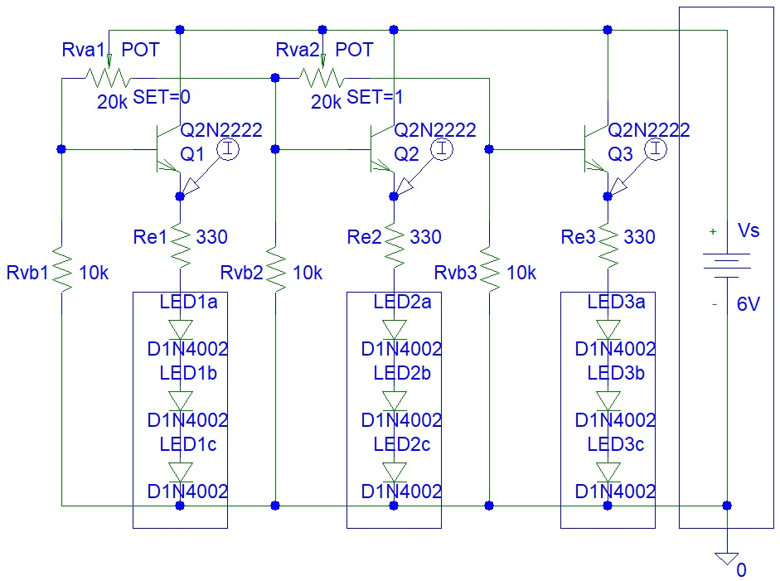
Transistor Lights
You only need transistors if you are using high current LEDs.

Slide 7
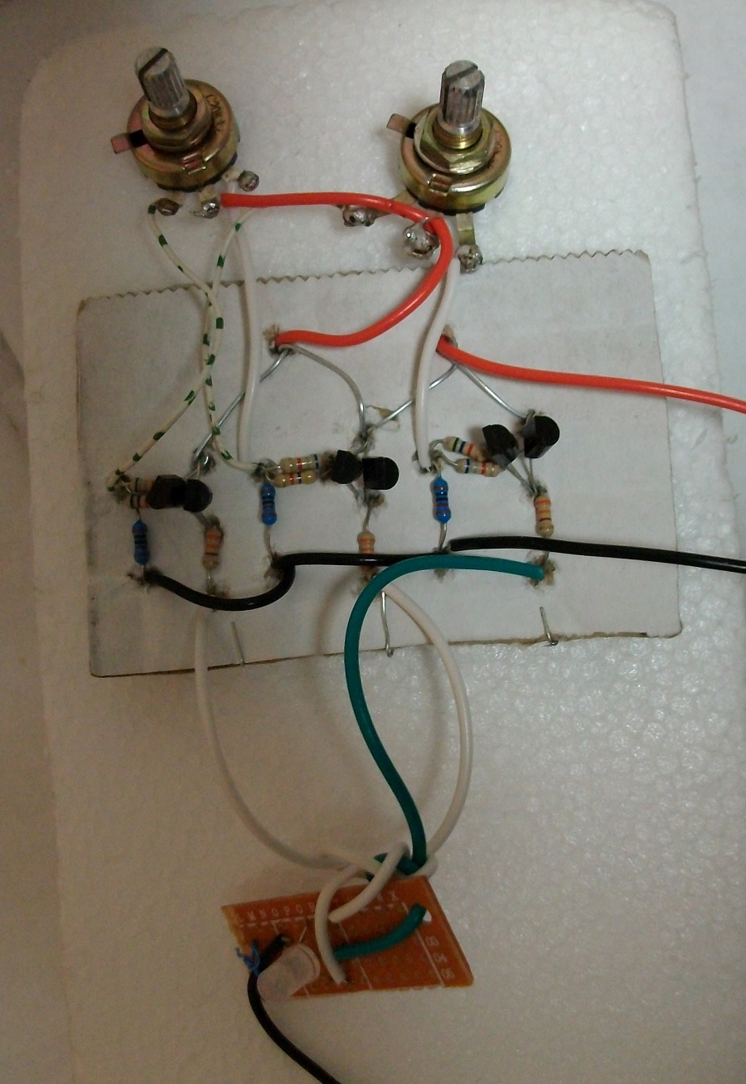
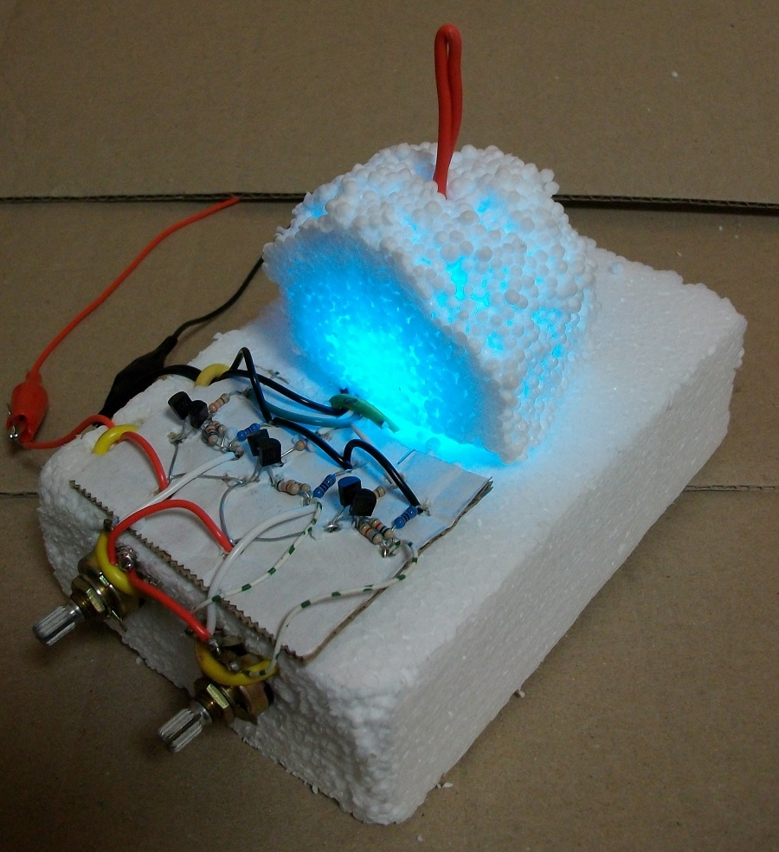
Transistor Lights Photos
Photo:

Slide 8

Transistor Lights Video
You can watch this video:

Slide 9
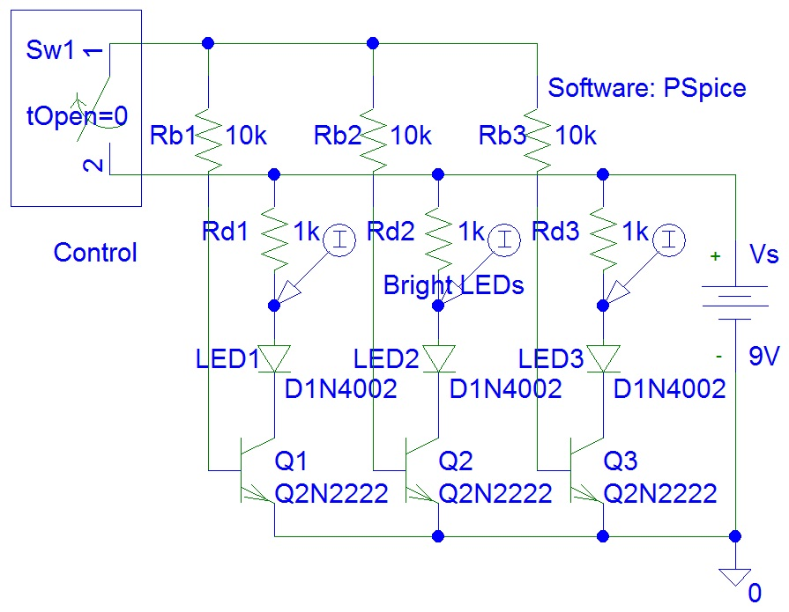
Transistor LED Driver
Circuit design:

Slide 10
References
https://instructables.com/member/recycledcircuits
https://hackaday.io/recycledcircuits
https://instructables.com/member/recycledcomponents
https://hackaday.io/recycledcomponents
https://instructables.com/member/usedcomponents
https://hackaday.io/usedcomponents
https://instructables.com/member/recycledplanets
https://hackaday.io/recycledplanets
https://instructables.com/member/recycledsculptures
https://hackaday.io/recycledsculptures

Slide 11
References
https://instructables.com/member/diyelectronics
https://hackaday.io/diyelectronics
https://instructables.com/member/simplecircuits
https://hackaday.io/simplecircuits
https://instructables.com/member/cheapcircuits
https://hackaday.io/cheapcircuits
https://instructables.com/member/supercircuits
https://hackaday.io/supercircuits
https://instructables.com/member/basicmechanics
https://hackaday.io/basicmechanics

Slide 12
References
https://instructables.com/member/webaerospace
https://hackaday.io/webaerospace
https://instructables.com/member/webphotos
https://hackaday.io/webphotos
https://instructables.com/member/simplecomponents
https://hackaday.io/simplecomponents
https://instructables.com/member/cheapcomponents
https://hackaday.io/cheapcomponents
https://instructables.com/member/lowcostcircuits
https://hackaday.io/lowcostcircuits

