Slide 1
Sustainable Other Circuits
Jim Honeyman
jim@4volts.com
Dr Mark Glickman
drmarkglickman@yahoo.com

Slide 2
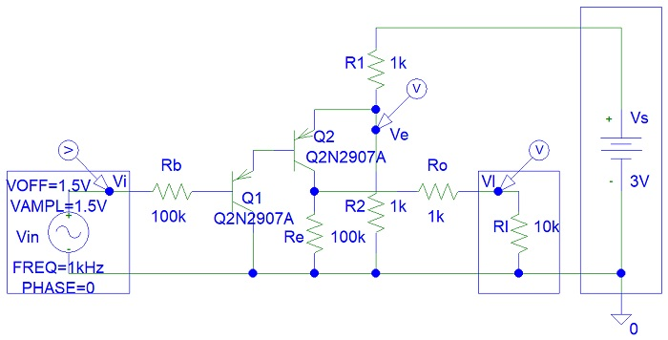
Transistor Comparator
Circuit 1:

Slide 3
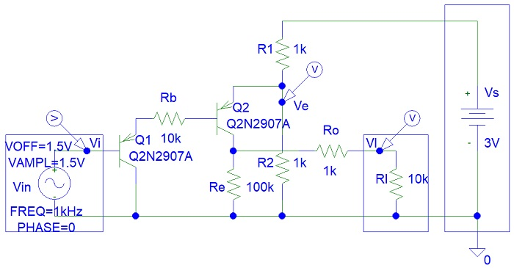
Transistor Comparator
Circuit 2:

Slide 4
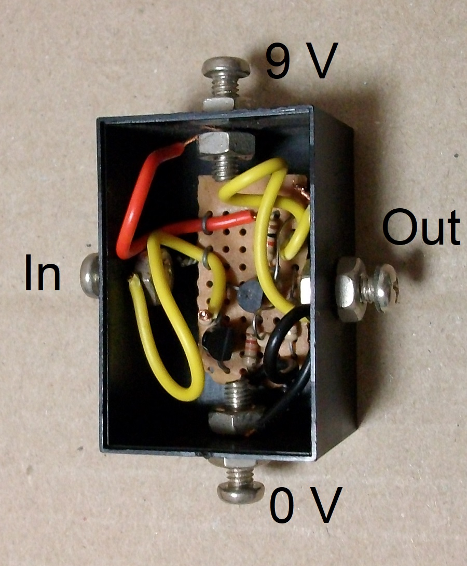
Transistor Comparator
Photo:

Slide 5
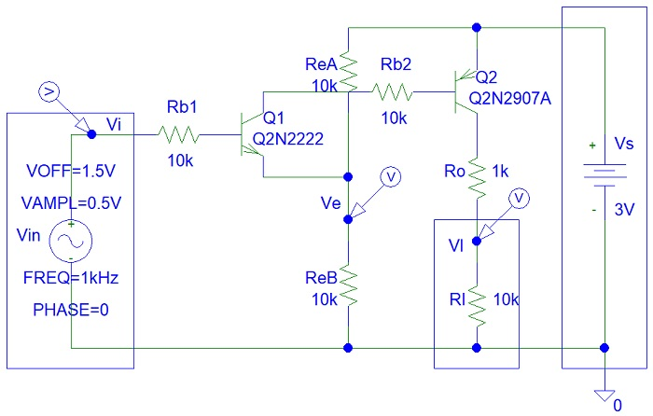
Transistor Comparator
Circuit 3:

Slide 6
References
https://instructables.com/member/recycledcircuits
https://hackaday.io/recycledcircuits
https://instructables.com/member/recycledcomponents
https://hackaday.io/recycledcomponents
https://instructables.com/member/usedcomponents
https://hackaday.io/usedcomponents
https://instructables.com/member/recycledplanets
https://hackaday.io/recycledplanets
https://instructables.com/member/recycledsculptures
https://hackaday.io/recycledsculptures

Slide 7
References
https://instructables.com/member/diyelectronics
https://hackaday.io/diyelectronics
https://instructables.com/member/simplecircuits
https://hackaday.io/simplecircuits
https://instructables.com/member/cheapcircuits
https://hackaday.io/cheapcircuits
https://instructables.com/member/supercircuits
https://hackaday.io/supercircuits
https://instructables.com/member/basicmechanics
https://hackaday.io/basicmechanics

Slide 8
References
https://instructables.com/member/webaerospace
https://hackaday.io/webaerospace
https://instructables.com/member/webphotos
https://hackaday.io/webphotos
https://instructables.com/member/simplecomponents
https://hackaday.io/simplecomponents
https://instructables.com/member/cheapcomponents
https://hackaday.io/cheapcomponents
https://instructables.com/member/lowcostcircuits
https://hackaday.io/lowcostcircuits

