Slide 1
Sustainable Sensors
Jim Honeyman
jim@4volts.com
Dr Mark Glickman
drmarkglickman@yahoo.com

Slide 2
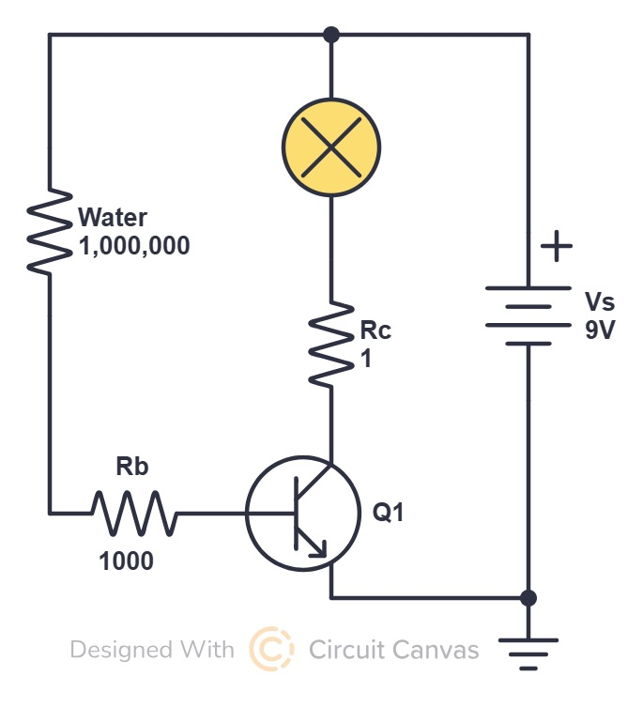
Water Sensor
This circuit can be made without a transistor.
However, transistor can drive higher current loads.

Slide 3
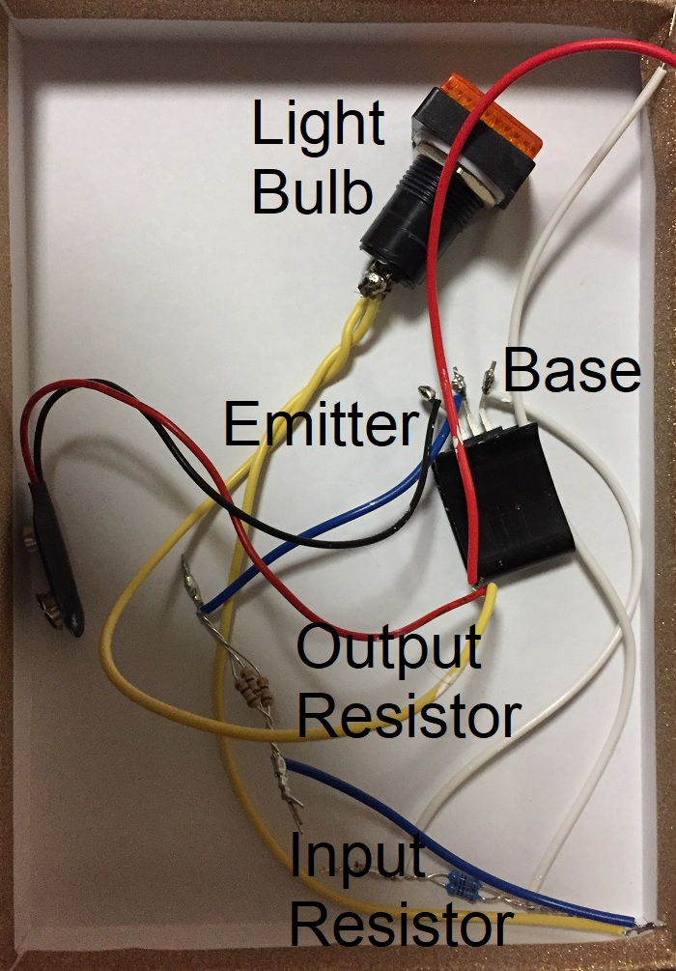
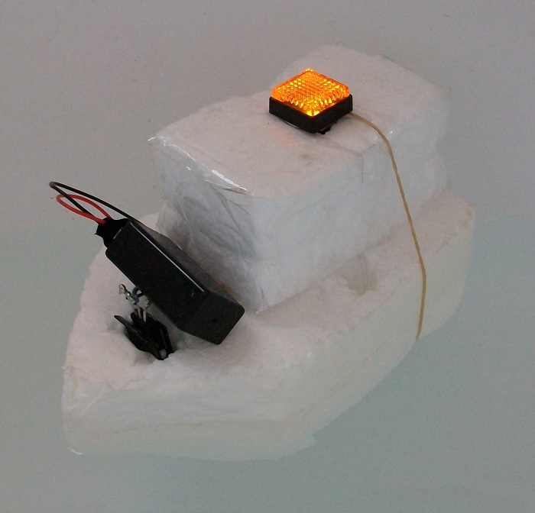
Water Sensor
Circuit photo:

Slide 4
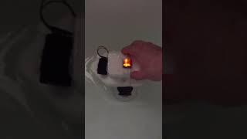
Water Sensor

Slide 5
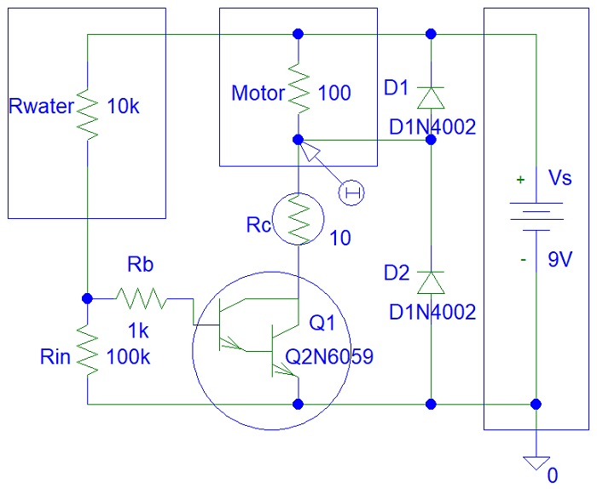
Water Boat
Circuit:

Slide 6
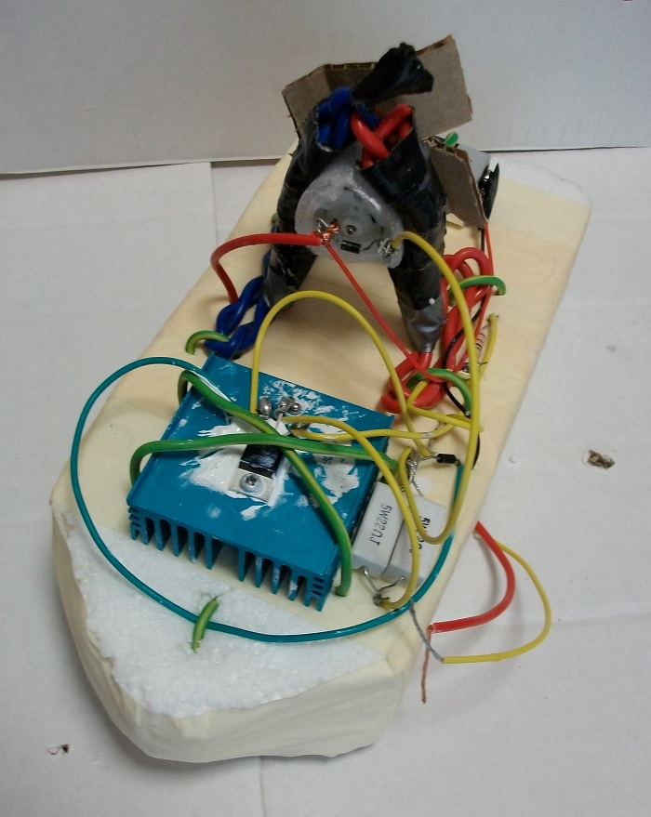
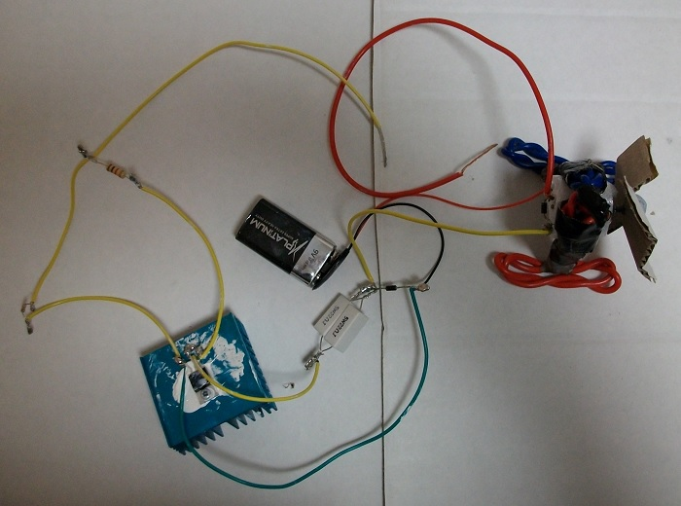
Water Boat
Photos:

Slide 7
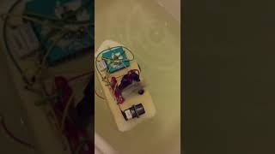
Water Boat

Slide 8
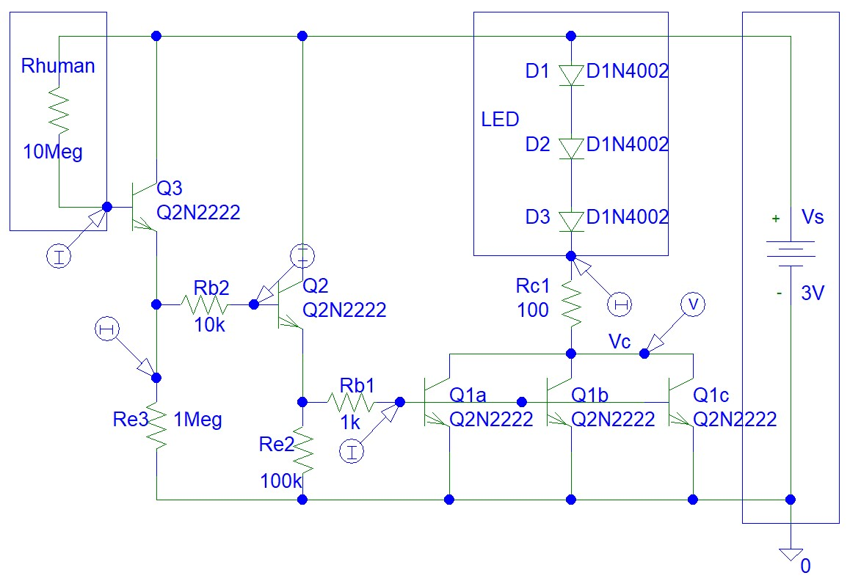
Touch Lamp
You actually do not need three transistors.
The circuit can work with two transistors.
However, used transistors have low current gain.
Rb2 and Re3 resistors are optional.

Slide 9
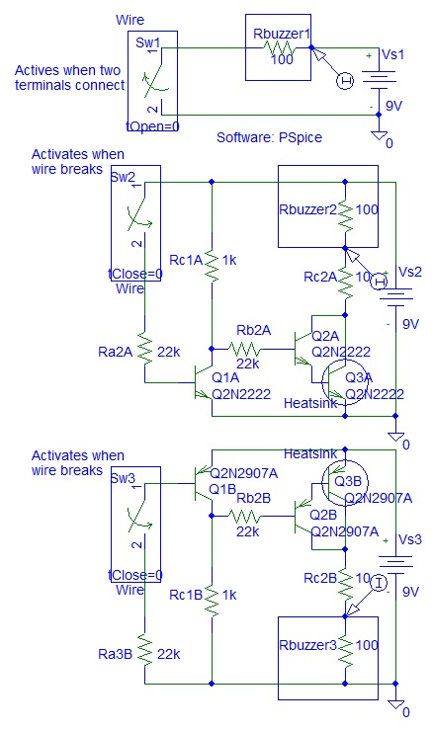
Security Systems
Circuit design:

Slide 10
References
https://instructables.com/member/recycledcircuits
https://hackaday.io/recycledcircuits
https://instructables.com/member/recycledcomponents
https://hackaday.io/recycledcomponents
https://instructables.com/member/usedcomponents
https://hackaday.io/usedcomponents
https://instructables.com/member/recycledplanets
https://hackaday.io/recycledplanets
https://instructables.com/member/recycledsculptures
https://hackaday.io/recycledsculptures

Slide 11
References
https://instructables.com/member/diyelectronics
https://hackaday.io/diyelectronics
https://instructables.com/member/simplecircuits
https://hackaday.io/simplecircuits
https://instructables.com/member/cheapcircuits
https://hackaday.io/cheapcircuits
https://instructables.com/member/supercircuits
https://hackaday.io/supercircuits
https://instructables.com/member/basicmechanics
https://hackaday.io/basicmechanics

Slide 12
References
https://instructables.com/member/webaerospace
https://hackaday.io/webaerospace
https://instructables.com/member/webphotos
https://hackaday.io/webphotos
https://instructables.com/member/simplecomponents
https://hackaday.io/simplecomponents
https://instructables.com/member/cheapcomponents
https://hackaday.io/cheapcomponents
https://instructables.com/member/lowcostcircuits
https://hackaday.io/lowcostcircuits

