Slide 1
Sustainable Basics
Jim Honeyman
jim@4volts.com
Dr Mark Glickman
drmarkglickman@yahoo.com

Slide 2
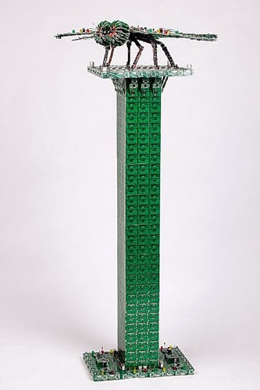
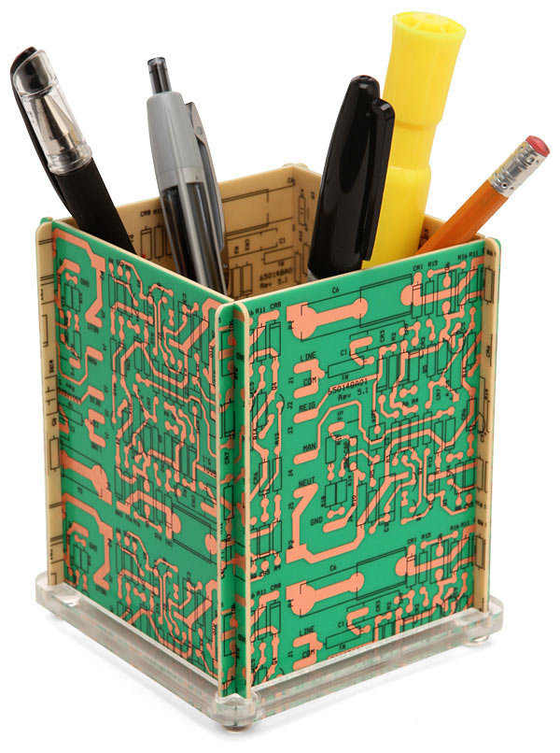
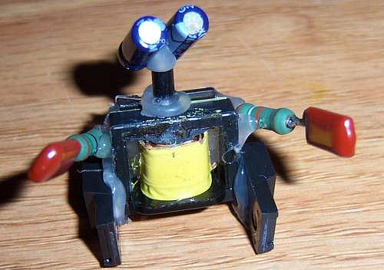
Recycled Circuits Items
This image you can find on Google search:

Slide 3
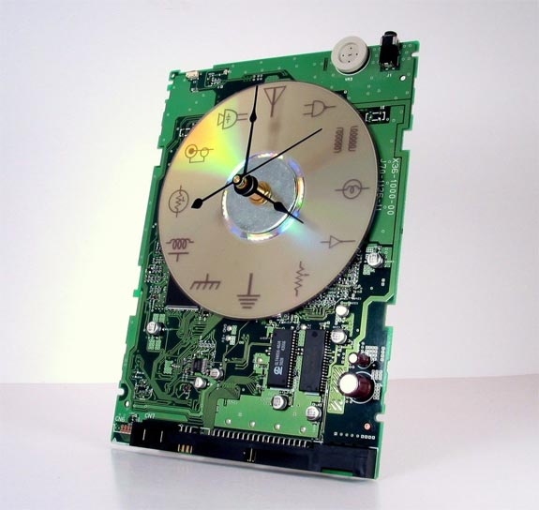
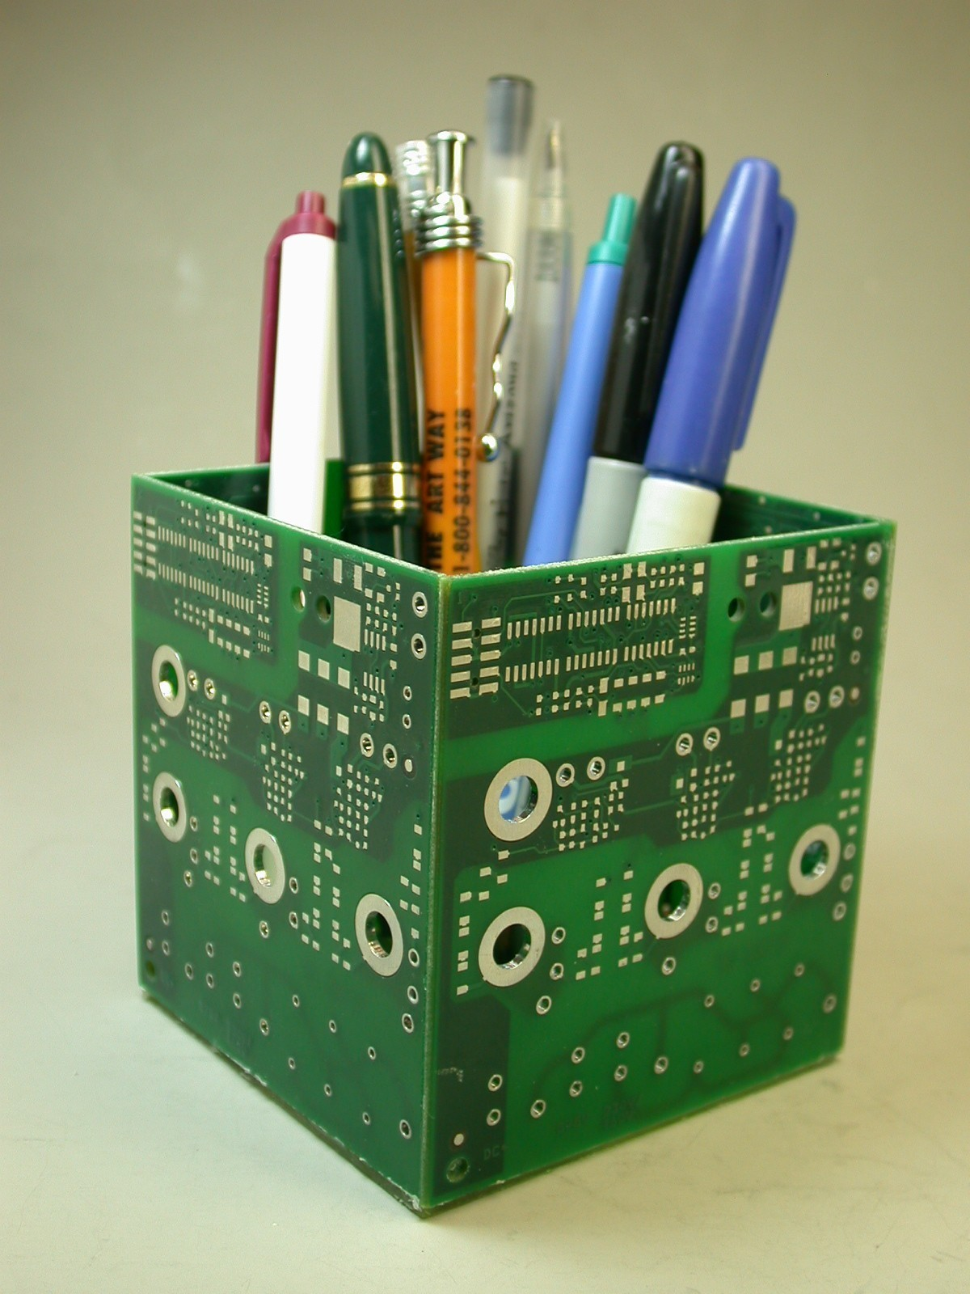
Recycled Circuits Items
This image you can find on Google search:

Slide 4
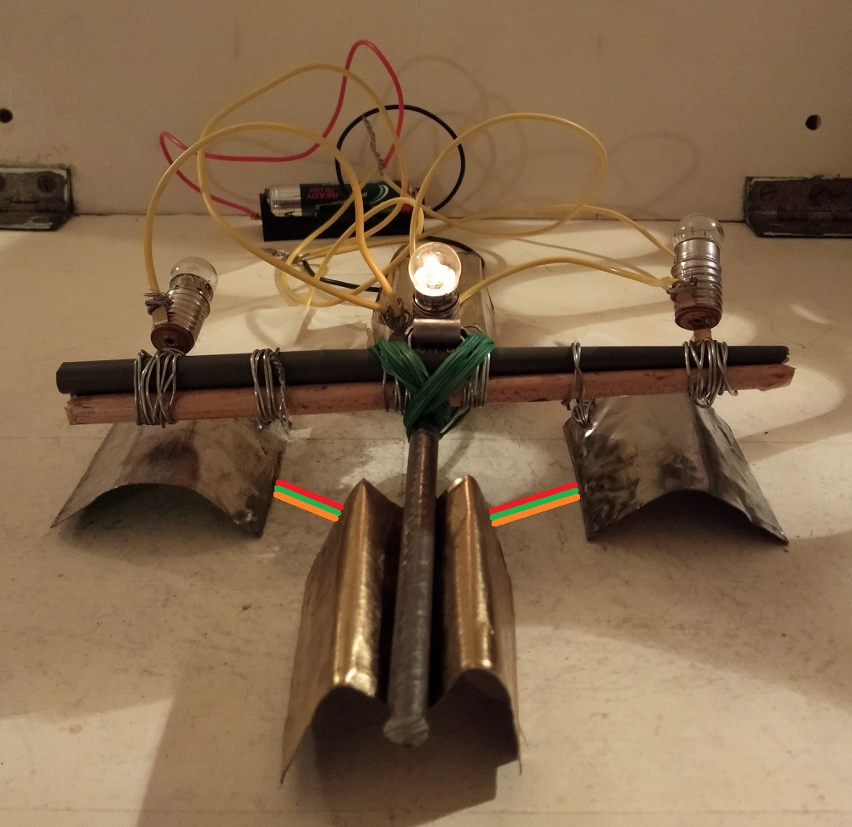
Light Bulbs Seesaw
Photo:

Slide 5
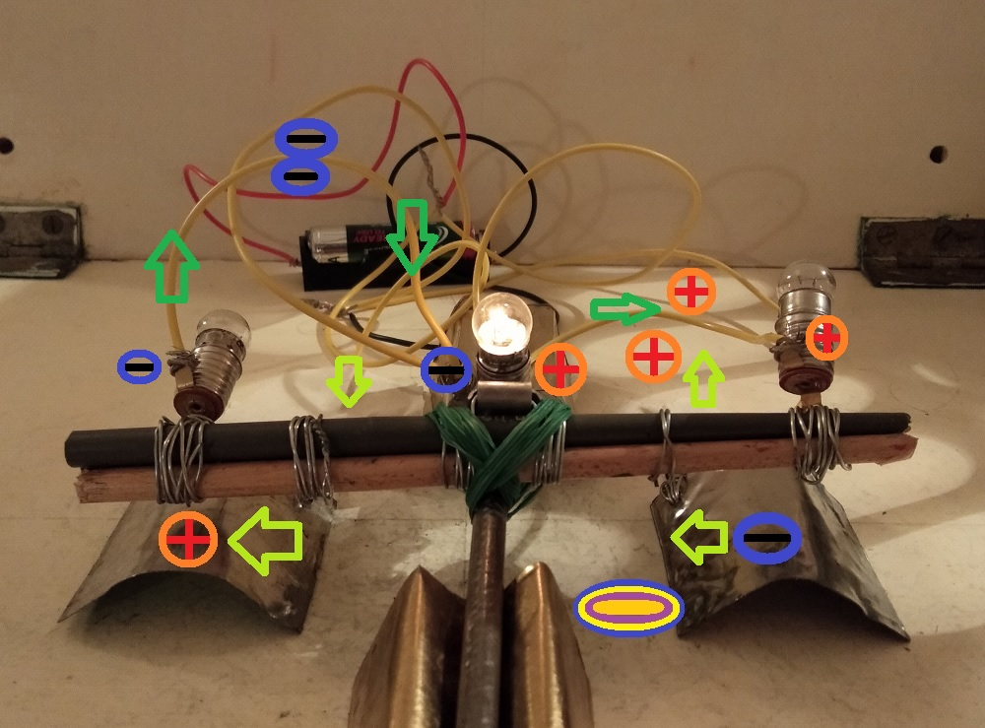
Light Bulbs Seesaw
Circuit:

Slide 6
Light Bulbs Seesaw video
Please watch this video:
https://www.youtube.com/shorts/QtWqEkBk3Yg

Slide 7
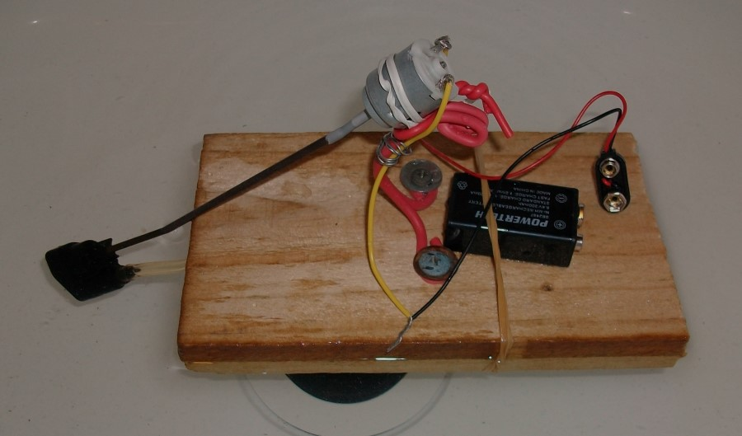
Water Pump Boat
The pump creates thrust for the boat to move.

Slide 8
Water Pump Boat Video
https://www.youtube.com/shorts/MTbryWZ8I-0

Slide 9
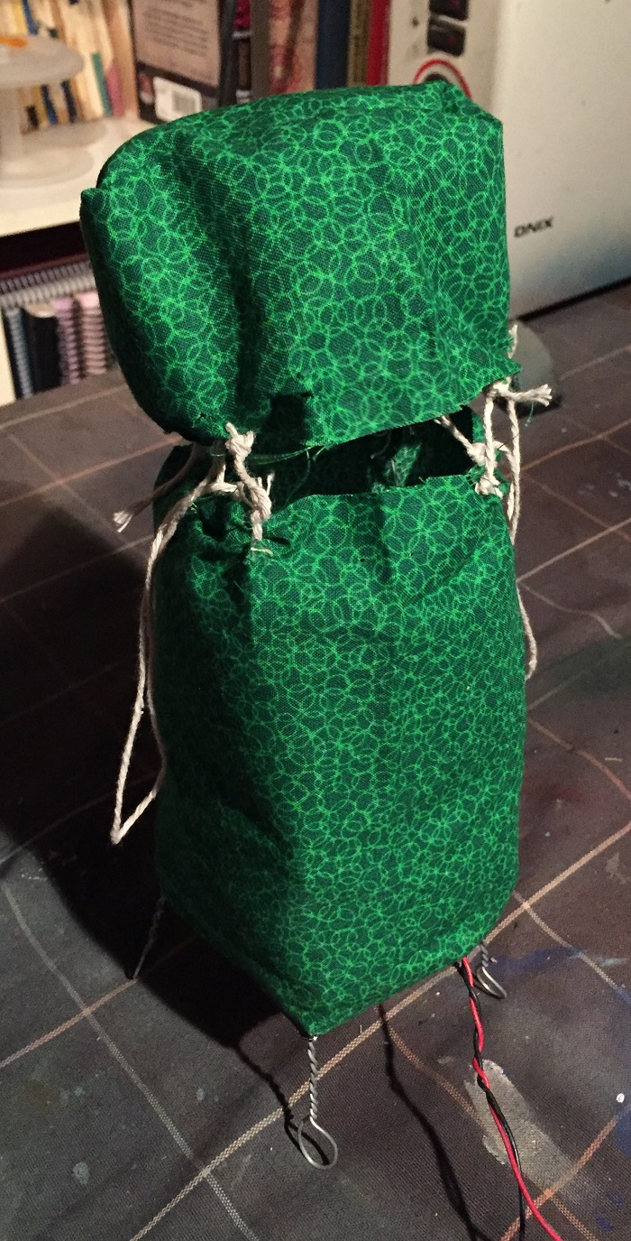
Wind Sculptures
Computer fans:

Slide 10
Wind Sculpture Video
https://www.youtube.com/shorts/Jm0lS0PSdtU

Slide 11
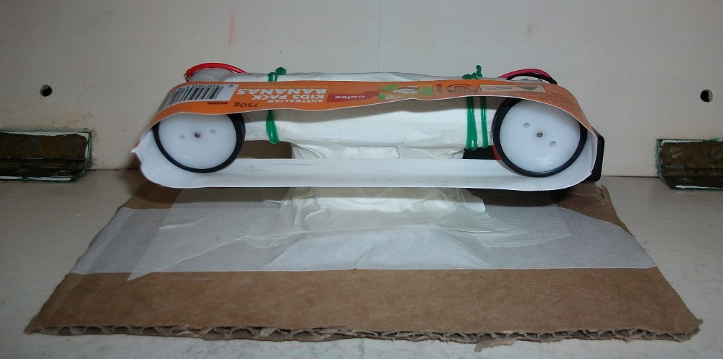
Conveyor Belt
Factory conveyor belt:

Slide 12
Conveyor Belt Video
https://www.youtube.com/shorts/rMmRxfZ1Dz4

Slide 13
References
https://instructables.com/member/recycledcircuits
https://hackaday.io/recycledcircuits
https://instructables.com/member/recycledcomponents
https://hackaday.io/recycledcomponents
https://instructables.com/member/usedcomponents
https://hackaday.io/usedcomponents
https://instructables.com/member/recycledplanets
https://hackaday.io/recycledplanets
https://instructables.com/member/recycledsculptures
https://hackaday.io/recycledsculptures

Slide 14
References
https://instructables.com/member/diyelectronics
https://hackaday.io/diyelectronics
https://instructables.com/member/simplecircuits
https://hackaday.io/simplecircuits
https://instructables.com/member/cheapcircuits
https://hackaday.io/cheapcircuits
https://instructables.com/member/supercircuits
https://hackaday.io/supercircuits
https://instructables.com/member/basicmechanics
https://hackaday.io/basicmechanics

Slide 15
References
https://instructables.com/member/webaerospace
https://hackaday.io/webaerospace
https://instructables.com/member/webphotos
https://hackaday.io/webphotos
https://instructables.com/member/simplecomponents
https://hackaday.io/simplecomponents
https://instructables.com/member/cheapcomponents
https://hackaday.io/cheapcomponents
https://instructables.com/member/lowcostcircuits
https://hackaday.io/lowcostcircuits

