Slide 1
Primary School
Sustainable Tools
Jim Honeyman
jim@4volts.com
Dr Mark Glickman
drmarkglickman@yahoo.com

Slide 2
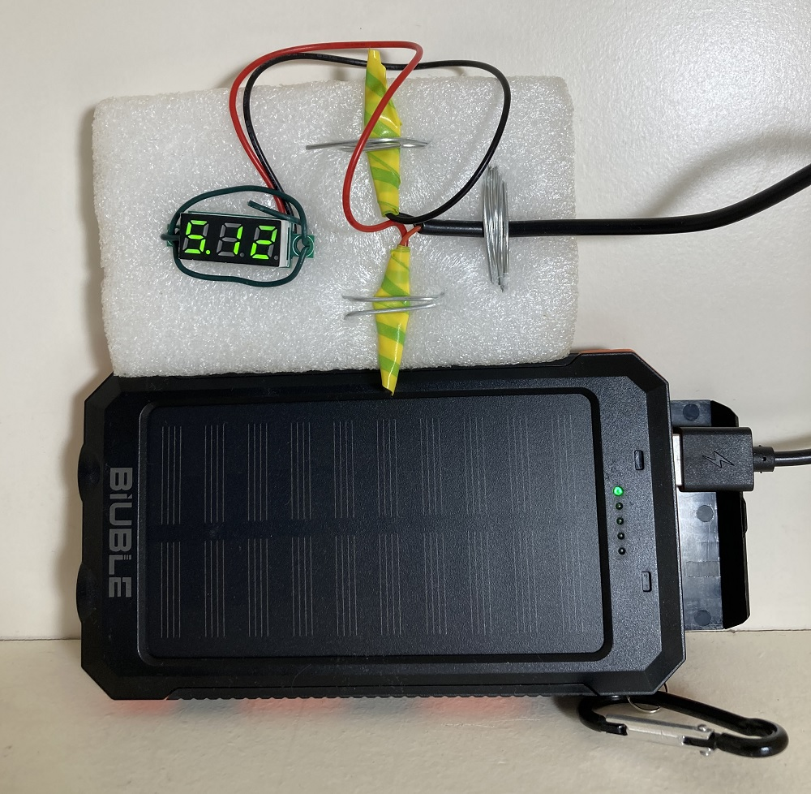
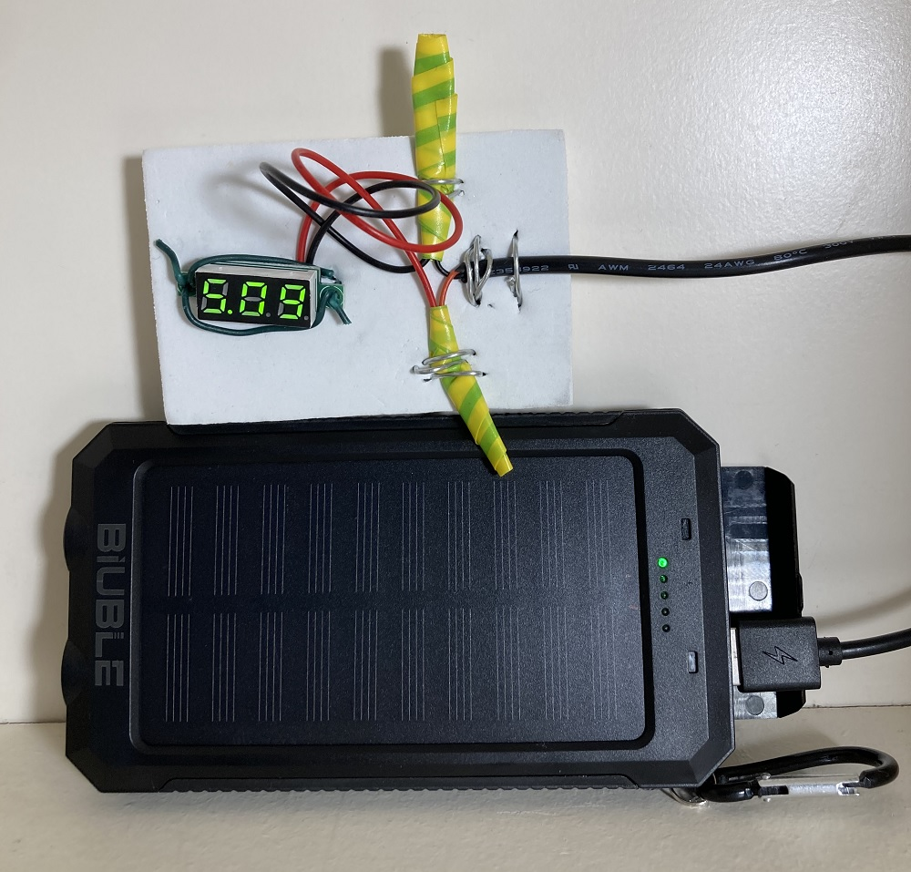
USB Voltage Testers Photos
Different batteries show different voltages:

Slide 3
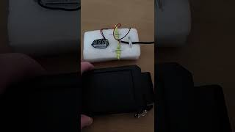
USB Voltage Testers Videos

Slide 4
References
https://instructables.com/member/recycledcircuits
https://hackaday.io/recycledcircuits
https://instructables.com/member/recycledcomponents
https://hackaday.io/recycledcomponents
https://instructables.com/member/usedcomponents
https://hackaday.io/usedcomponents
https://instructables.com/member/recycledplanets
https://hackaday.io/recycledplanets
https://instructables.com/member/recycledsculptures
https://hackaday.io/recycledsculptures

Slide 5
References
https://instructables.com/member/diyelectronics
https://hackaday.io/diyelectronics
https://instructables.com/member/simplecircuits
https://hackaday.io/simplecircuits
https://instructables.com/member/cheapcircuits
https://hackaday.io/cheapcircuits
https://instructables.com/member/supercircuits
https://hackaday.io/supercircuits
https://instructables.com/member/basicmechanics
https://hackaday.io/basicmechanics

Slide 6
References
https://instructables.com/member/webaerospace
https://hackaday.io/webaerospace
https://instructables.com/member/webphotos
https://hackaday.io/webphotos
https://instructables.com/member/simplecomponents
https://hackaday.io/simplecomponents
https://instructables.com/member/cheapcomponents
https://hackaday.io/cheapcomponents
https://instructables.com/member/lowcostcircuits
https://hackaday.io/lowcostcircuits

